Slide 1
HALBA EYE CLINIC
Installation from A-Z

Slide 2
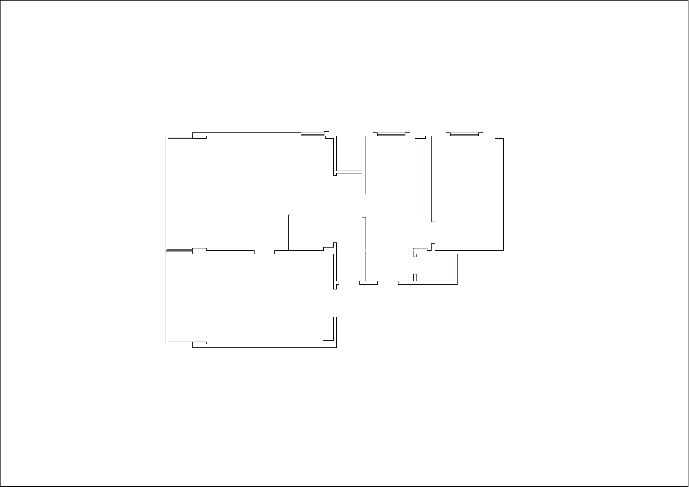
Primary Elevation of the Clinic

Slide 3
Primary Elevation of the Clinic
1- No patient Circulation Presented.
2- Multiple Patient Entry.
3- One Bathroom .
4- No Electrical Plan Existence.
5- No Data And Phone Plan Existence.
6- No Electrical Back Up Existence.

Slide 4
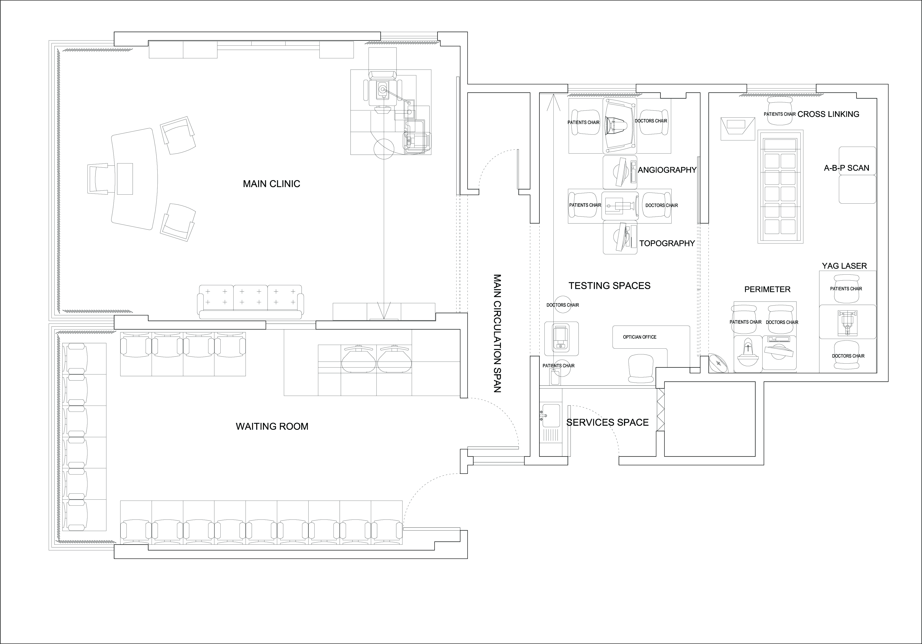
Final Elevation of the Clinic

Slide 5
Final Elevation of the Clinic
1- Creating patient circulation from the entrance till exit.
2- spacious Main clinic.
3- waiting room up to 25 patients.
4- 2 Restrooms, 1 service space including small kitchen.
5- optician Office with office and machinery .
6- imaging and treatment devices are separated.
7- re-install full electrical plan with back up, data and telephone / intercom system.

Slide 6
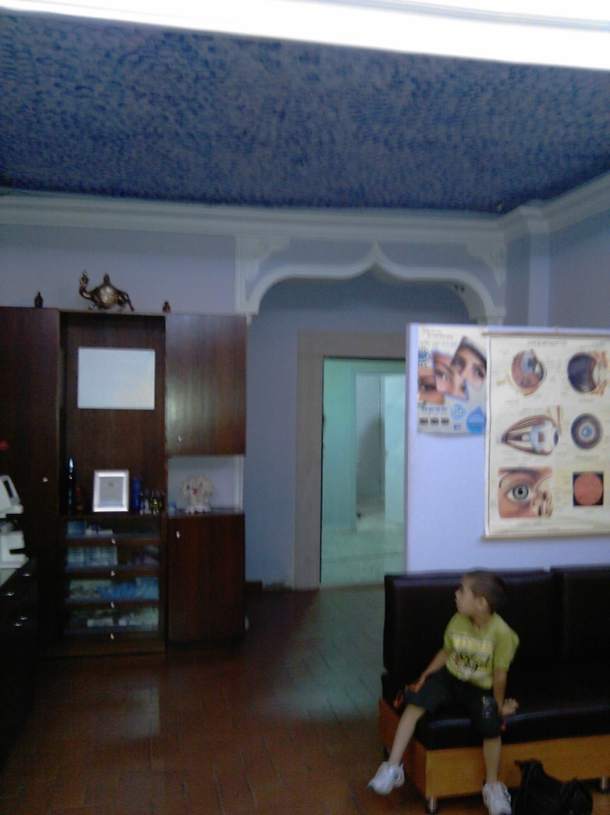
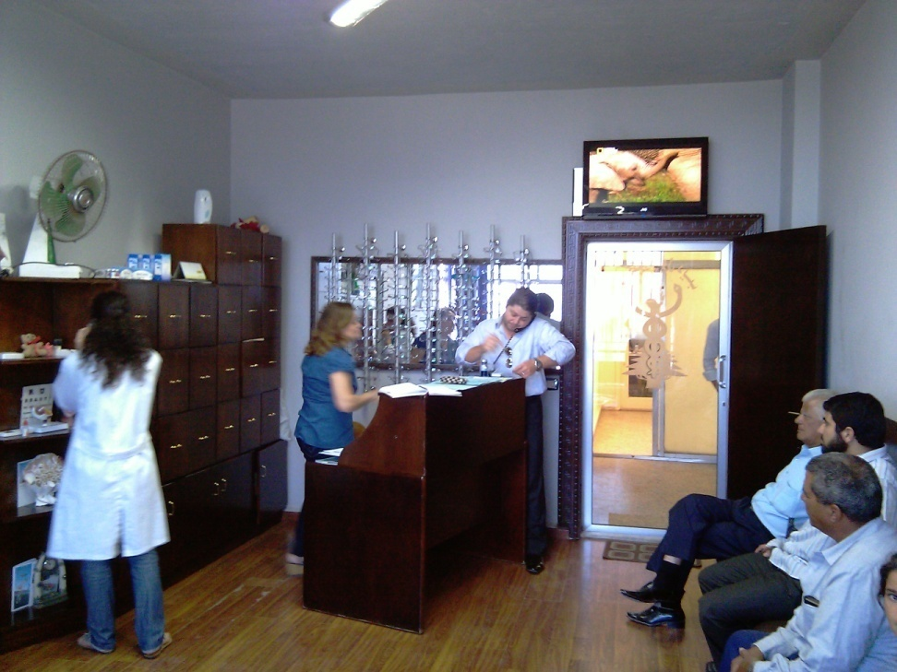
Primary Clinic Photos

Slide 7
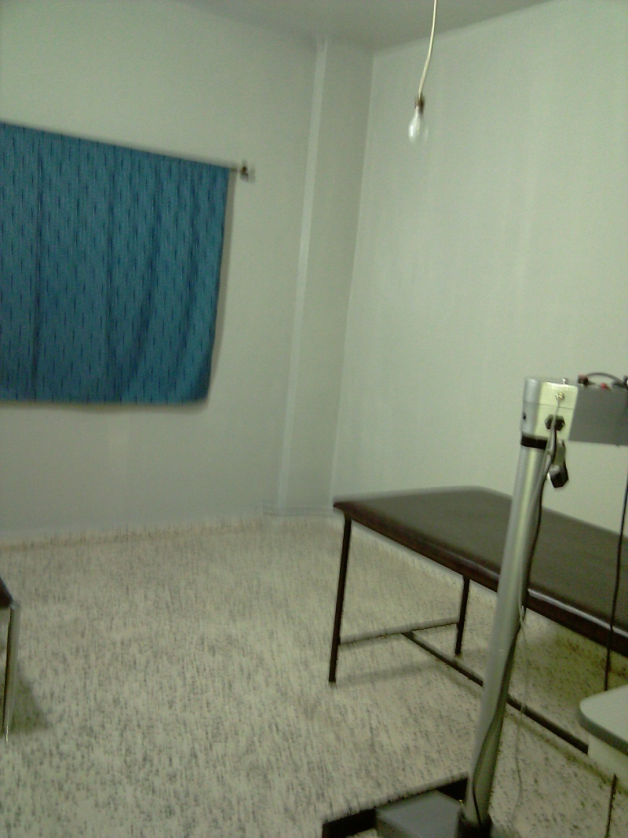
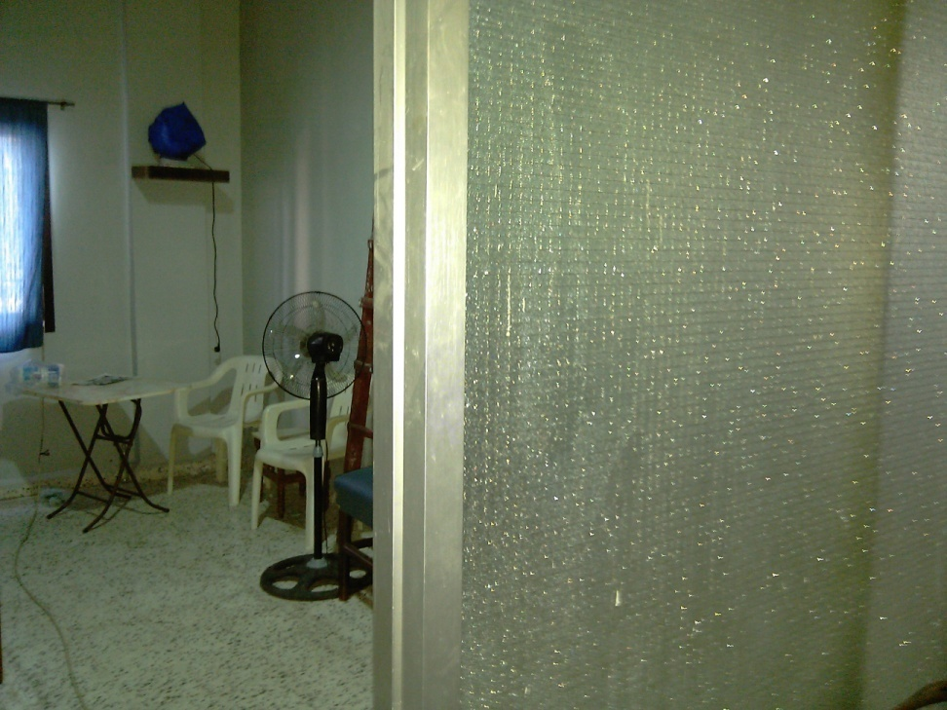
Primary Clinic Photos

Slide 8
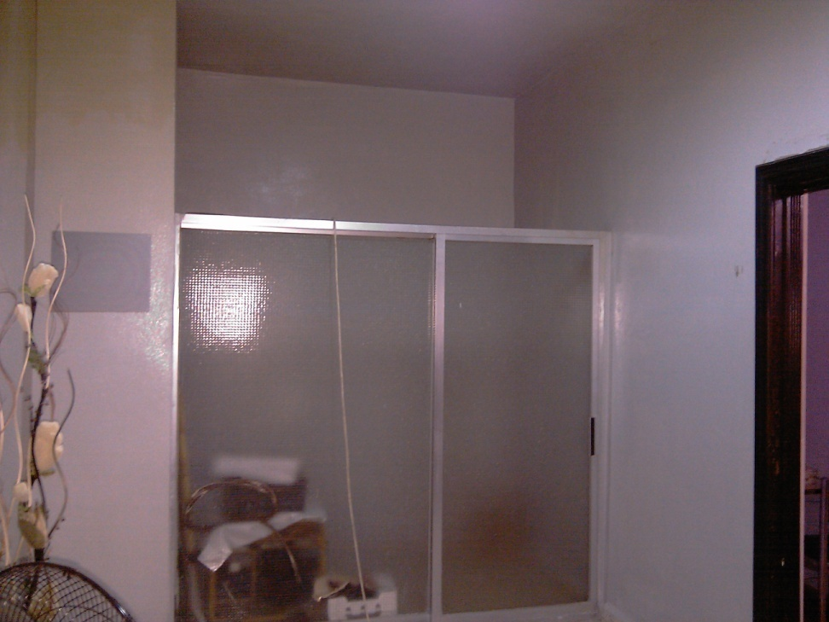
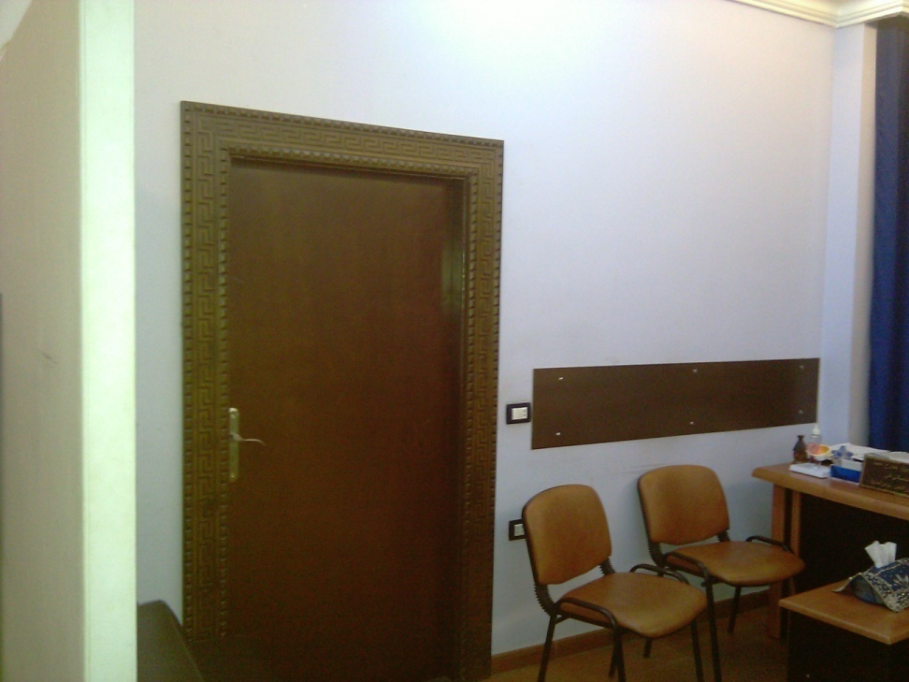
Primary Clinic Photos

Slide 9
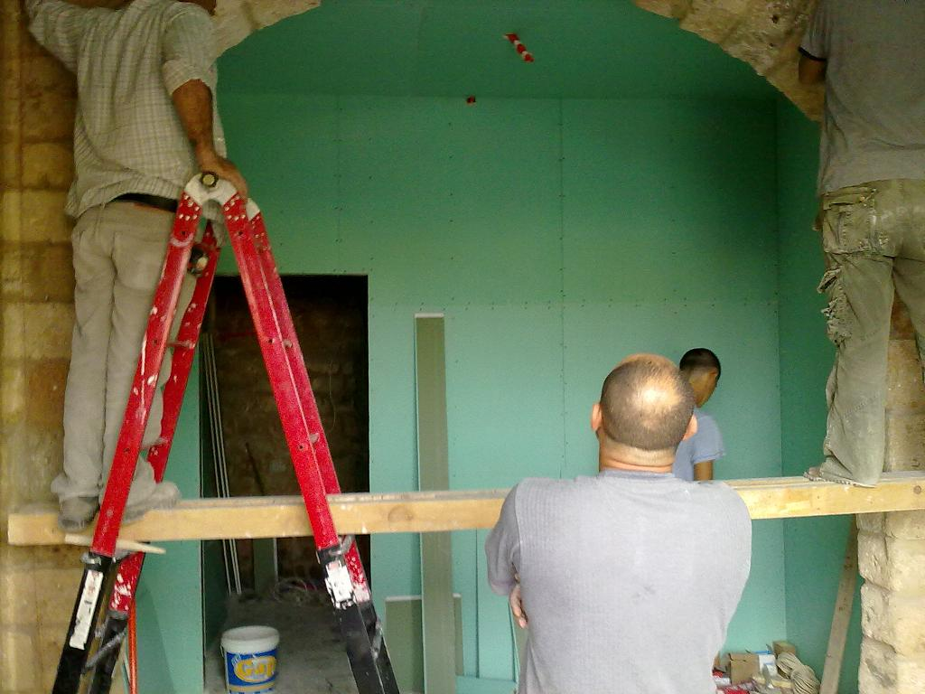
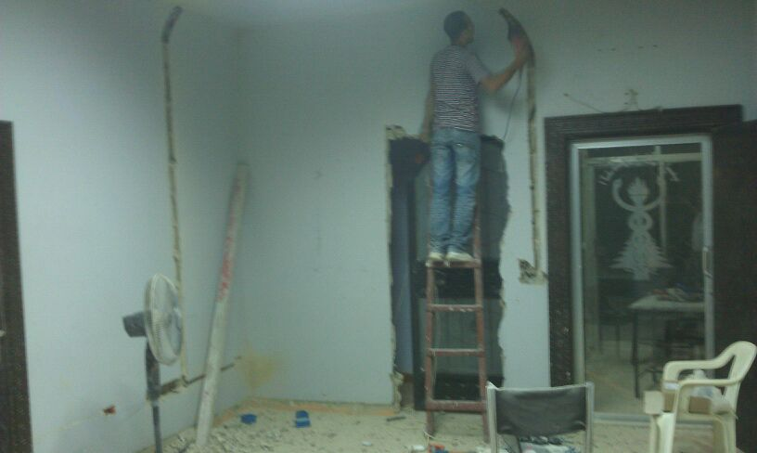
Changing the Decoration

Slide 10
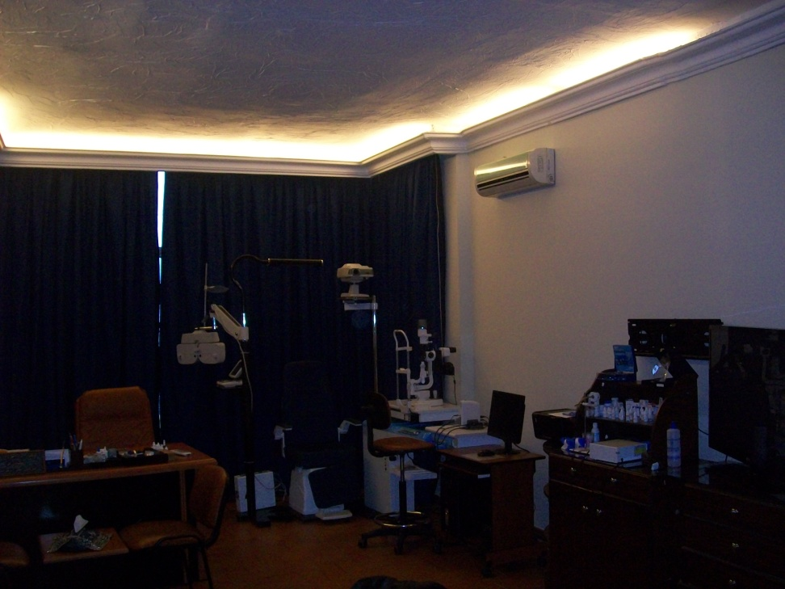
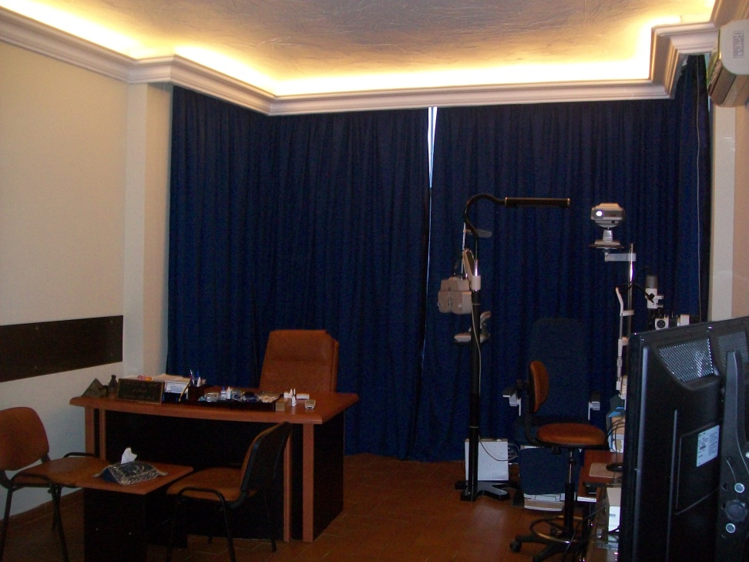
Installing and Modification

Slide 11
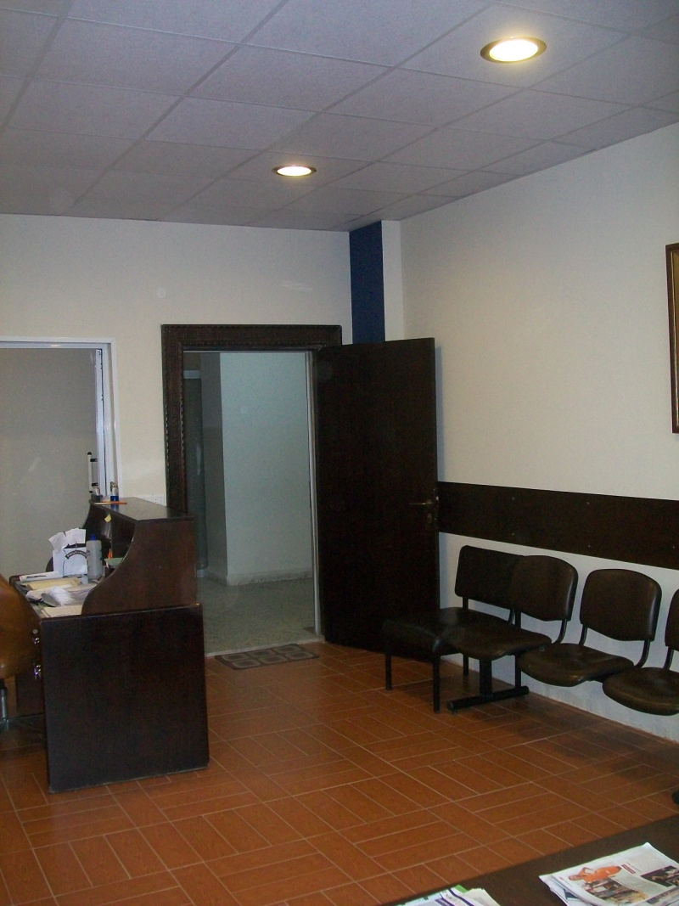
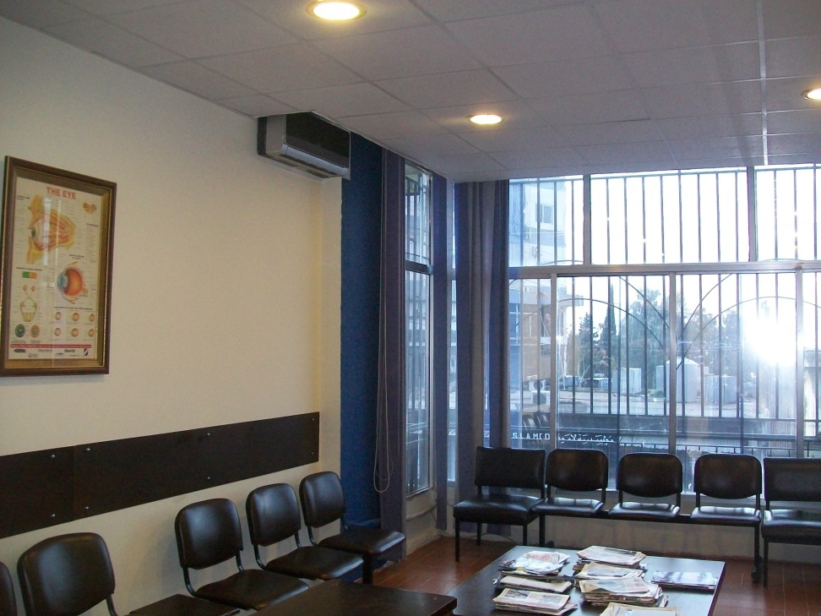
Installing and Modification

Slide 12
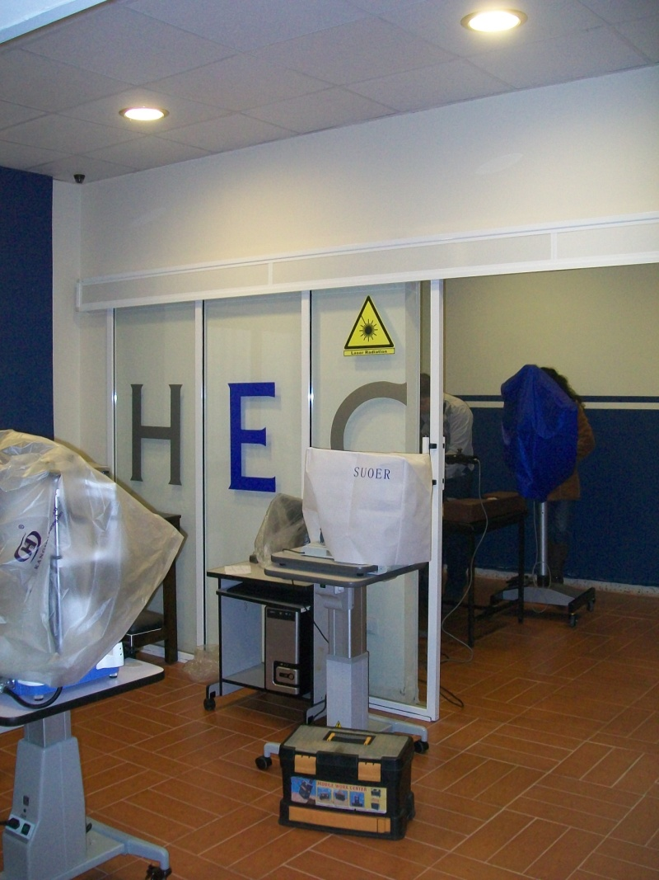
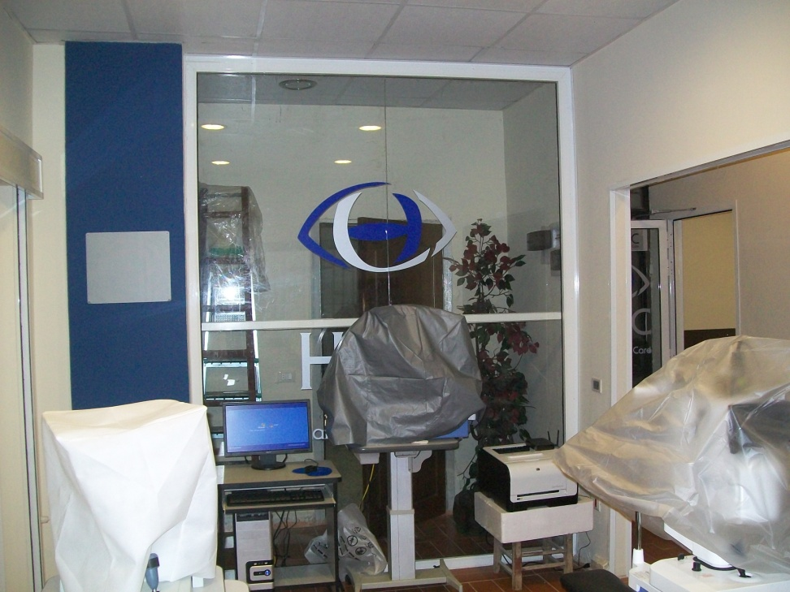
Installing and Modification

Slide 13
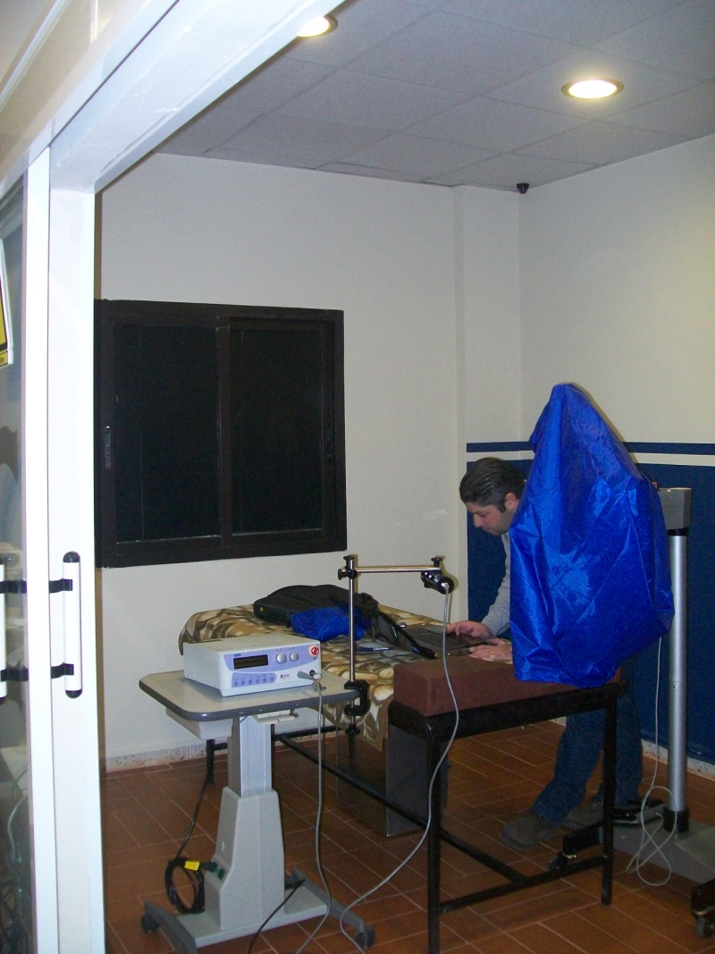
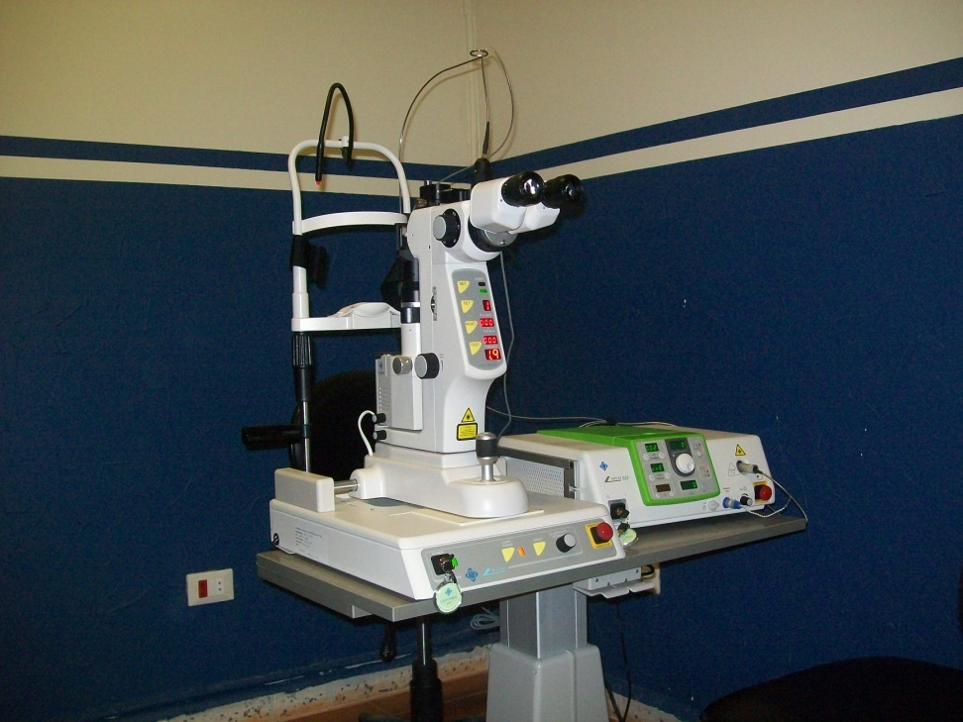
Installing and Modification

Slide 14
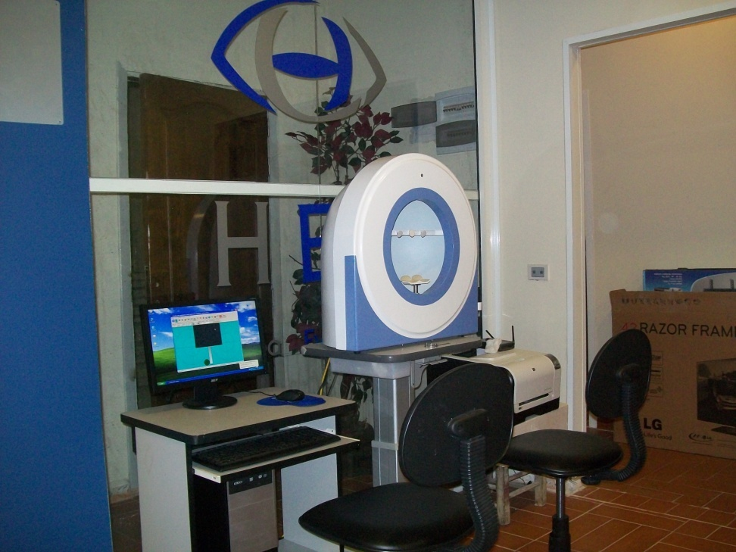
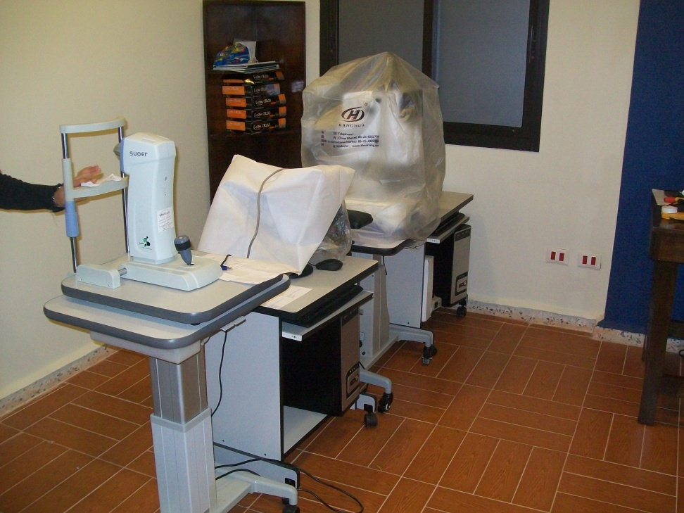
Installing and Modification

Slide 15
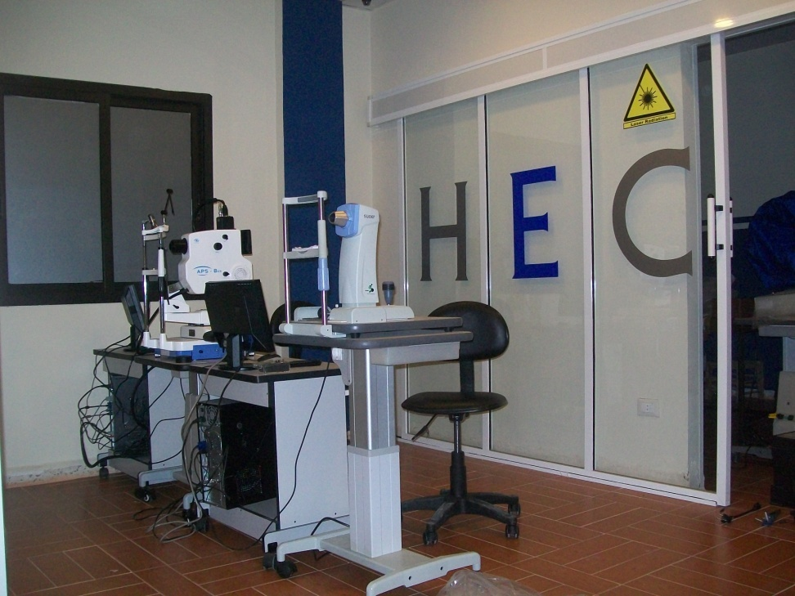
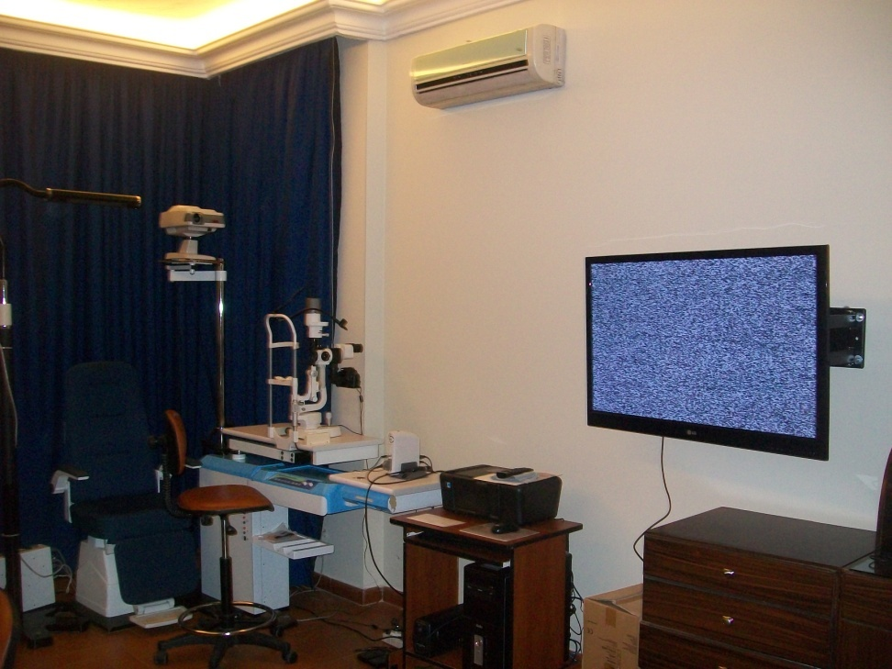
Installing and Modification

Slide 16
Project Time and Cost
Total Project Time: 2 Months and 4 days.
Total Project space: 155 m2, all covered
Job Offered:
Sanitary and Plumbing
Complete area Installation of tiles
Complete area Paint Job
Furniture, Medical and non-medical
Computer Hardware, Networking and Software
Installation of 26 ophthalmic equipments including Lasers.
Complete Sterilization unit
Patient Monitoring and 24/7 Security Camera
Total Cost: 145,000.00 $ (Say one Hundred Forty Five Thousand U.S.Dollars )
Warranty period: Extended Warranty selected for consecutive 5 Years from the delivery date.

